Slide 1
Auburn-USDA CS Clinic
Liaison Meeting (2/20/25)

Slide 2
Project Blurb
Do we have everyone’s approval?

Slide 3
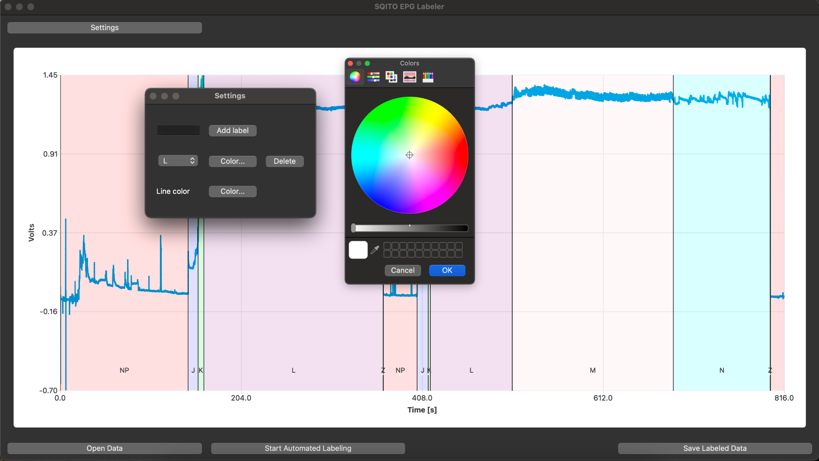
GUI Settings Menu

Slide 4
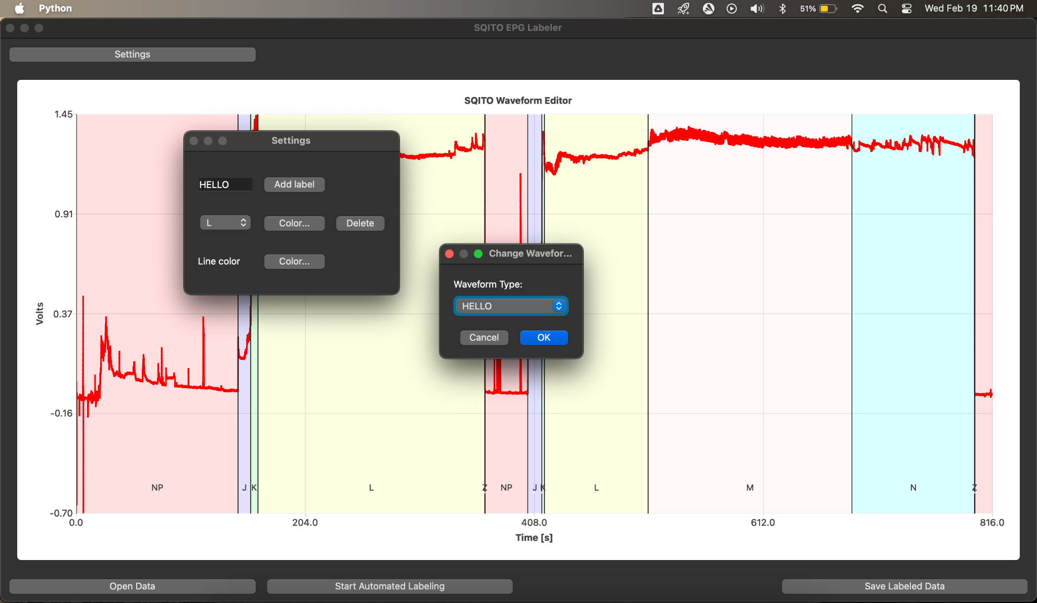

Slide 5
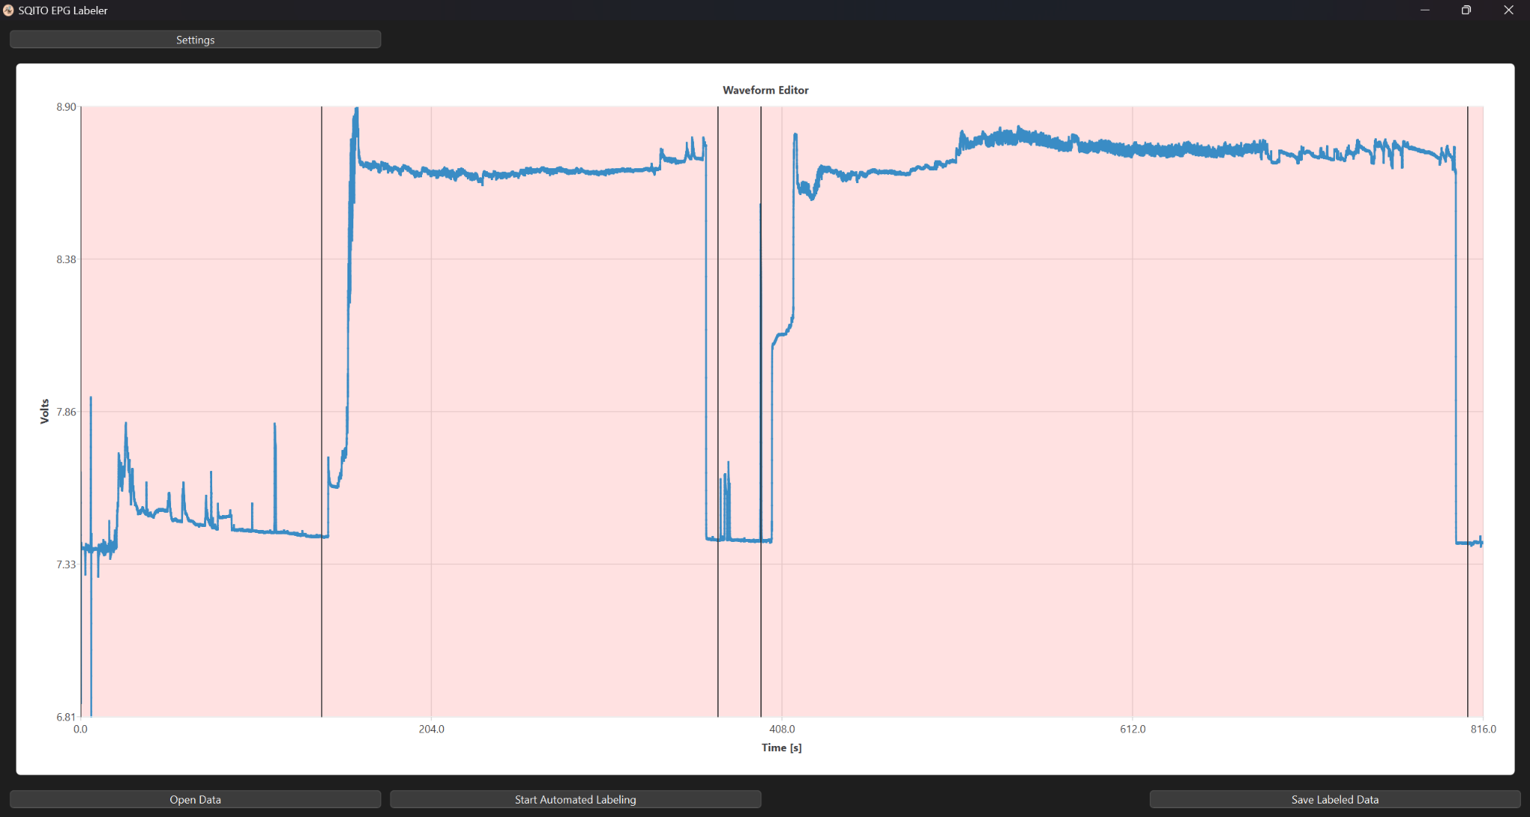
Mehrezat’s Updates!
The birth of GUI probe splitting…

Slide 6

Meet SCIDO!
Supervised
Classification of
Insect
Data and
Observations

Slide 7
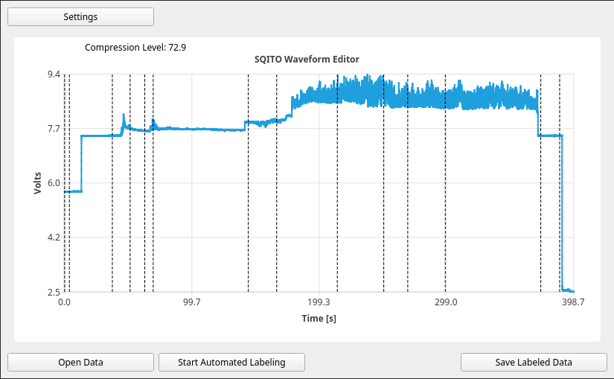
Comment markers… work in progress

Slide 8
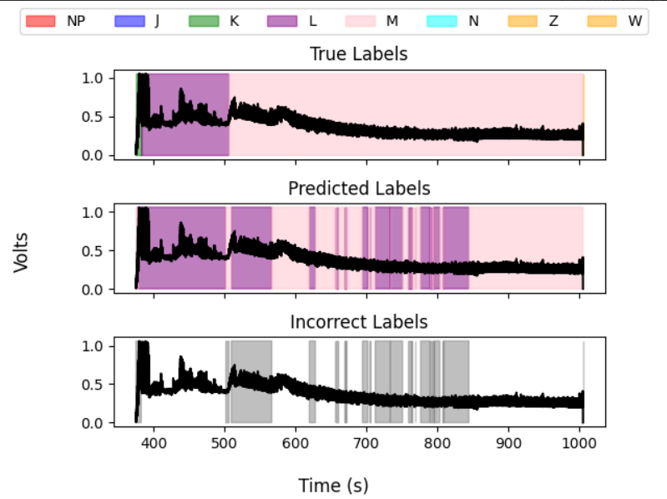
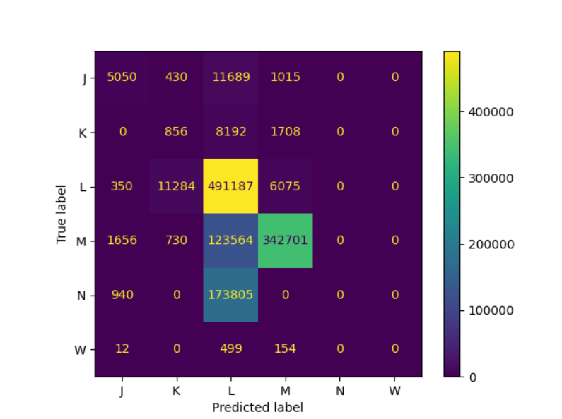
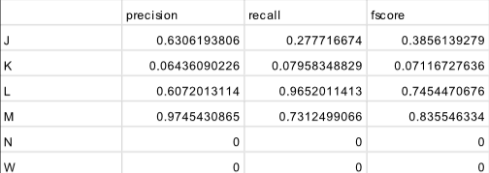
Data Package
Ran baseline models for RF, TCN, UNet with benchmark script, generated some reports!
Includes statistics, confusion matrix, and example outputs
Will send data over with minutes.

Slide 9
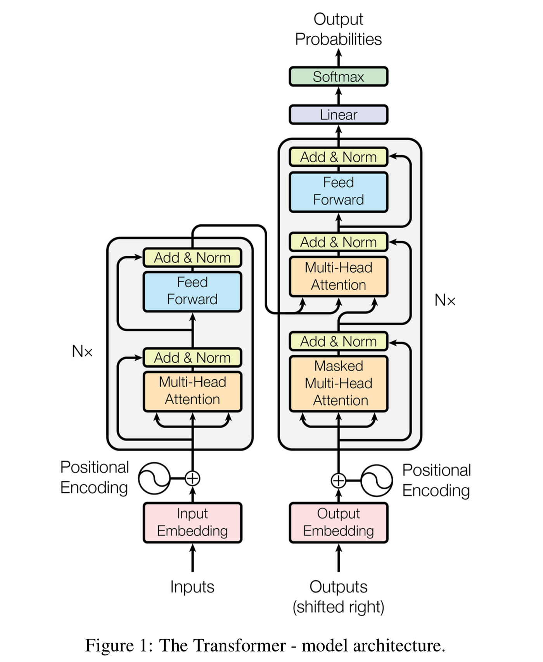
Transformer
As Transformers are popular tools right now (that’s what the T in ChatGPT stands for), we think a survey of potential labeling methods would be incomplete without considering transformers
We will give a more detailed description of transformers once we have data to present
This will likely be the final model we consider

Slide 10
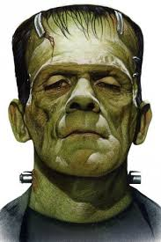

Data Augmentation
Implemented:
Augment_concat_self
Augment_concat_other
Augment_warp_overall
Augment_warp_by_state
Augment_change_amplitude_overall
Augment_change_amplitude_by_state
Augment_noise_voltage_overall
Augment_noise_voltage_by_state
Augment_franken
Not implemented:
Mixup
Frequency-domain noise
Simulate different RI levels

